Slide 1
Global Terrorism Data Analysis
Bharath Devarajan
Juhi Shrivastava
Manikandan Swaminathan
Nitin Rao

Slide 2
QUESTIONs
1. Predict the number of kills/scale of a terror attack based on the attack characteristics.
2. Predicting when a terrorist attack is successful (leading to structural damage or loss of life).
3. Predicting the region of the attack.
4. Identify the possible terrorist group responsible for the attack.
5. Can we predict future terrorist activities?

Slide 3
METHODOLOGY: CRISP-DM
Business Understanding
Data Understanding
Data Preparation
Modelling
Evaluation of models

Slide 4
BUSINESS UNDERSTANDING
To Analyse the terrorism dataset and mine patterns of terror activities
Dataset contains data about terror events from 1970 to 2015
Maintained by National Consortium for the Study of Terrorism and Responses to Terrorism (START).

Slide 5
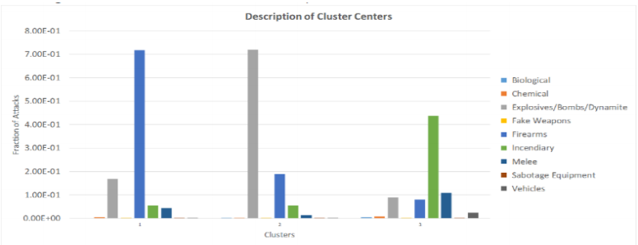
DATA UNDERSTANDING
Key Visualizations were plotted to get insights over the dataset

Slide 6
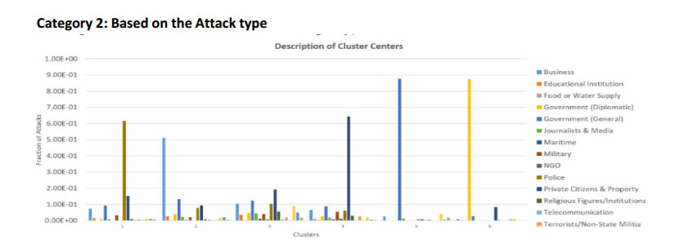

Slide 7
Data Preparation
Converting Categorical values to Numerical attributes using Label encoding
Handling Missing Values using imputation
Train test split
Principal Component Analysis for dimensionality reduction

Slide 8
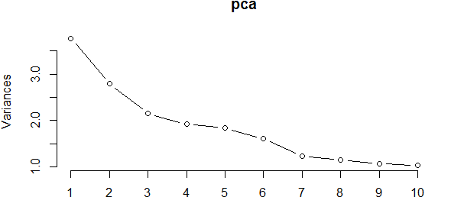
PCA

Slide 9
MODELLING
Models selected to answer the questions are,
Generalized linear model (Quasi Poisson family)
Random Forest
K Nearest Neighbours
Support Vector Machine
Multinomial Naïve Bayes

Slide 10
EVALUATION
Question | Model | Accuracy
1) Predicting number of kills | Random Forest | 83.4%
2)Will a terrorist attack be successful? | Support Vector Machine | 76.3%
3) Predicting the region of the attack (Country) | K Nearest Neighbours | 60.4%
4) Identify the possible terrorist group responsible for the attack. | Random Forest | 72.4%
5) Predicting future terrorist attacks | Multinomial Naïve Bayes | 47.4 %

Slide 11
THANK YOU

